Slide 1
PEGASUS 2020-2021
Meet and Greet &
Opportunities
Roy Schwab and Jessica Barrington

Slide 2
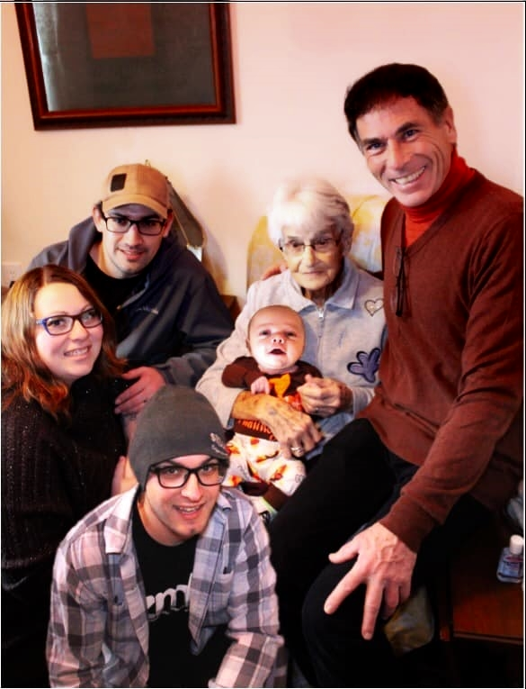
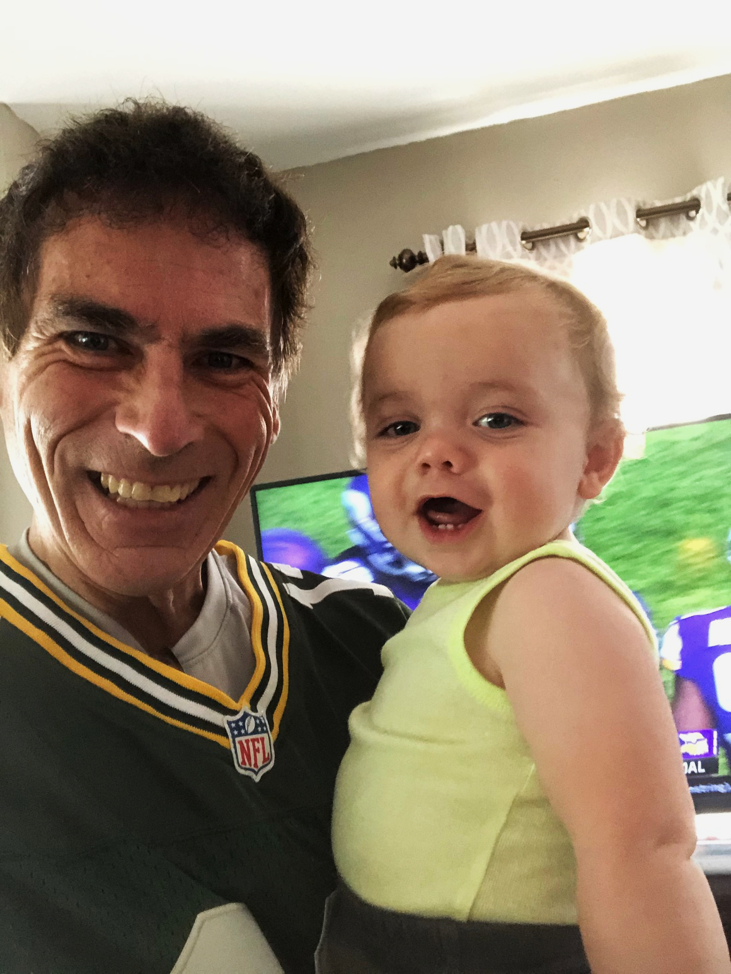
Roy Schwab, MEd
PJSD Pegasus/GT Coordinator H.S. & Elem.
Bachelor’s Degrees: Lakeland University in Education and Theater
Master’s Degree: Cardinal Stritch University in Educational Technology
Adjunct Professor for Viterbo University, UW-Green Bay, and Marian College
PJSD Health and Wellness Leader
Strong background in STEAM learning and Animal Science
Musical Theater Director and Actor for 40+ years
Professional Announcer and Steward for National Horse Shows
Fitness, wellness, downhill skiing, technology & family time
BEST part of life is being a Dad and Grandpa!

Slide 3
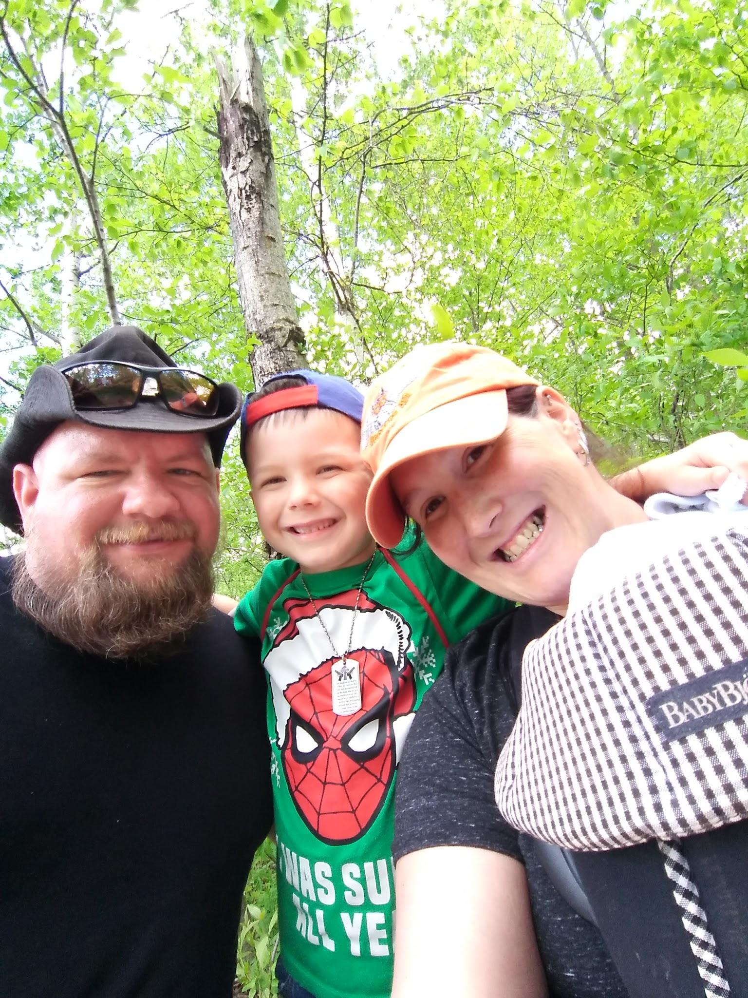
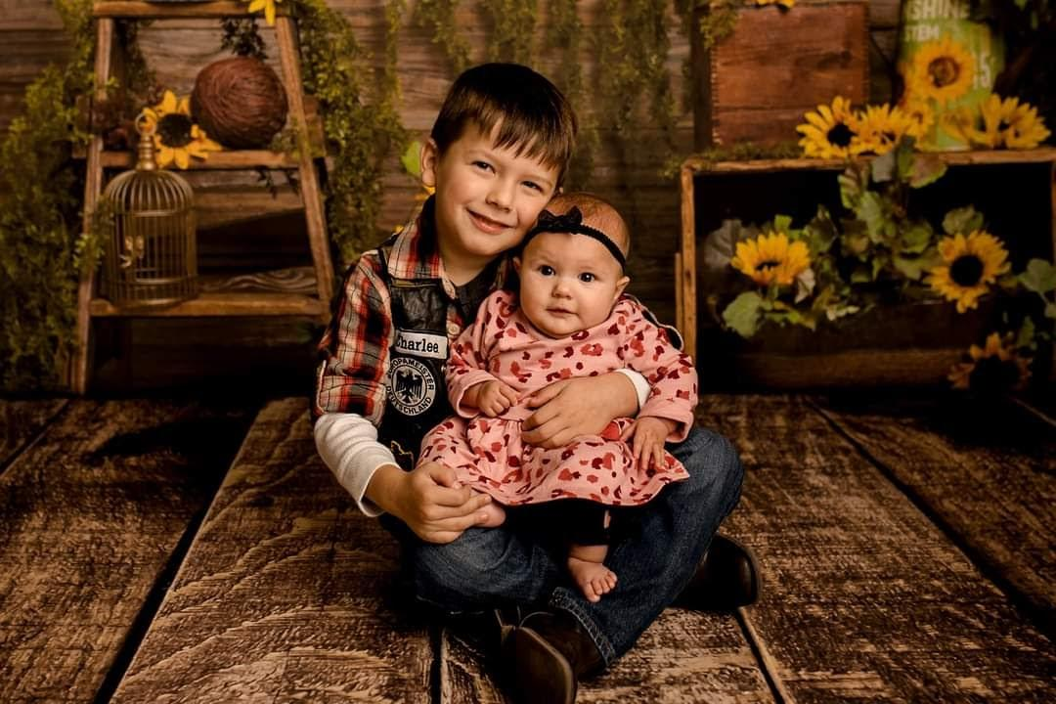
Jessica Barrington MEd
Bachelor’s Degree: 2006 UWO
Master’s Degree: 2014 UWGB
Beginning 14th year at Riverview Middle School
German Cultures and Pegasus Teacher
Cross Country Coach
Math Club Coach
Spelling Bee Coordinator

Slide 4
Opportunities for your GT child at Fairview, Horizon, and Parkview
First-fourth graders at Fairview, Horizon, and Parkview receive enrichment in grade level cohorts each week, along with additional opportunities and resources on each grade level/school Google Classroom. Virtual students use the Google Classroom resources.
Topics are varied, interest based, chosen with the input of the students through student surveys. Topics include: team building/problem solving activities, computer coding and robotics activities, STEAM activities, theater/performance activities, extension of classroom activities, and more...

Slide 5
Additional Elementary G.T. Opportunities:
Pegasus Google Classroom Choice Boards with many opportunities.
New York Times has a variety of contests geared toward the G.T. student throughout the year. https://www.nytimes.com/2020/07/15/learning/our-2020-21-student-contest-calendar.html
Weekly Pegasus/GT Thursday Thoughts sent out in Skyward contain many opportunities available throughout the year.
Our CESA 7 GT Consortium works collaboratively to provide resources and opportunities.
4th Grade Safety Patrol
Elementary STEAM Day

Slide 6
Opportunities for your GT child within the school day at Riverview
Fifth graders at Riverview receive enrichment within their homeroom pod for 30 minutes one time in a six day rotation
Students will be given choices for activities to work on this school year.
Students will NOT be required to work on things outside of their PEGASUS meeting time.
STEAM activities and challenging activities will be offered in person. Online students may participate from home if they choose.
Students DO NOT have to participate. If they choose to NOT participate, they must have written parent permission.

Slide 7
Opportunities for your GT child within the school day at Riverview
Sixth through Eighth Graders receive enrichment within the classroom setting- transition model
Placements are considered
The Academy- Nine week online LA enrichment course
Takes place of regular LA class- occasionally students are required to complete some coursework
Face to face meetings, weekly check ins
Ability to self motivate/monitor, high ability readers and writers
Variety of course offerings
Opportunities through our CESA 7 GT Consortium
Artistic Retreat, Young Authors, Great Decisions- virtual this year

Slide 8
Extracurriculars at Riverview
Sports
XC, Volleyball, Basketball, Wrestling
Musical
Forensics
Chess Club
Math Club
Yearbook
Student Council
Green Team
Jazz Band/Show Choir

Slide 9
High School Opportunities
GT High School Advisories and GT Coordinator Office Hours
Passion Project Independent Study course option for GT juniors and seniors through the GT Coordinator.
A wide variety of clubs and extracurriculars available to high school students that are very applicable to the GT students: http://www.plymouth.k12.wi.us/Schools/PHS/activities.html
There are many club extension activities that can enhance the G.T. student high school experience!
Advanced placement courses through recommendation, past performance and teacher approval
There are out of school competitions and opportunities, such as:
Math Competitions
Academic Bowl
Model UN
And many more...

Slide 10
Opportunities for your GT child outside the school day
Best place to look for opportunities outside of school:
www.plymouthgifted.weebly.com
Community Education offers some wonderful, local courses:
http://www.plymouth.k12.wi.us/Schools/COM/index.html
Local Theater Groups- TYA, Sheboygan Theatre Company, Lakeshore Productions, Inc., Dare to Dream, etc.
Plymouth Arts Center provides many opportunities: https://www.plymoutharts.org/
John Michael Kohler Arts Center also provides many opportunities: https://www.jmkac.org/home.html

Slide 11
Opportunities for Adults to Learn and Grow!
WATG Conference- VIRTUAL - October 18 -20 2020
Hands On, Minds On- Now More than Ever!
Teen Conference and Parent Conferences offered
https://www.watg.org/annual-conference.html

Slide 12
Future Inservice Dates
January 25th, 2021
Virtual
Topic: Family Game Night
Spring 2021- TBD

Slide 13
Activities for All!
The Kids Should See This... Smart videos for curious minds of all ages: https://thekidshouldseethis.com/
Ian Byrd: https://www.byrdseed.com/
Coding: https://code.org/learn
Set- online
Skyscraper- online
Ian Byrd: https://www.byrdseed.com/
Snake Oil
Tangrams
Qwirkle

Slide 14
Questions or Comments:
Roy Schwab: rschwab@gc.plymouth.k12.wi.us
Jessica Barrington: jbarrington@gc.plymouth.k12.wi.us
THANK YOU!

